Slide 1
University Ranking Model
Application Engineering and Development Assignment-3
Made By- Mitali Gupta Singh Pooja Kumari
Shreya Upplapati

Slide 2
Problem Statement
Building a software engineering design to measure the quality of education that universities deliver to their students by ascertaining the professional growth of graduates over a period of years.
Building a software engineering design to measure the quality of education that universities deliver to their students by ascertaining the professional growth of graduates over a period of years.
Notes:
Building a software engineering design to measure the quality of education that universities deliver to their students by ascertaining the professional growth of graduates over a period of years.

Slide 3
How to choose the best possible course for getting a job?

Slide 4
The Proposed Solution

Slide 5
Criteria for Ranking
Average GPA for each course
Most popular course
Total occupancy of each department
Total revenue generated by each department
The factors which affect the rating of the course have been emphasized upon directly to the ranking of the university

Slide 6
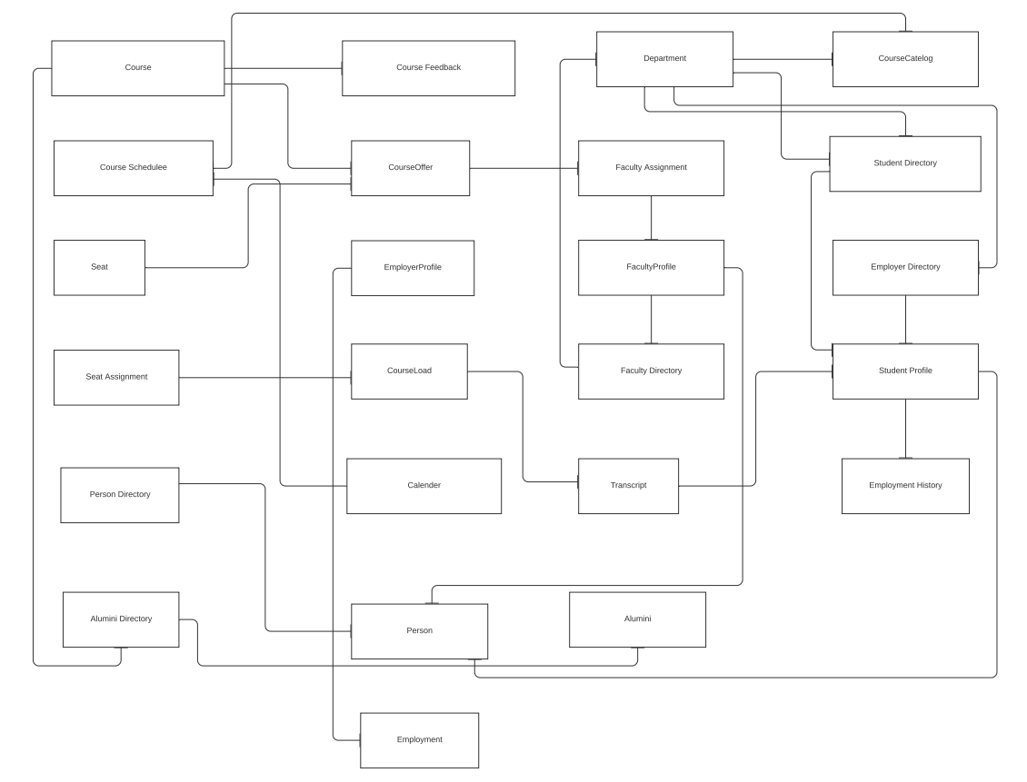
Object Diagram

Slide 7
Design Model
In order to create a performance measurement solution which analyses how faculty and courses contribute towards a students professional growth, it is imperative that first, the department should be able to track a student’s progress over years in a corporate environment plus to analyze which all courses helped the student in that and through that learn about what all changes and modifications are required in the curriculum.

Slide 8
Implementation

Slide 9
Data Generation
The data is generated through the faker package
The data is generated for a period of 6 years from 2014 - 2020
There are 4 departments- CS- Computer Science INFO- Information Systems INDS- Industrial ENGM- Engineering Management
Each department has 4 courses that are randomly generated
Each year has 3 semesters- Spring, Summer and Fall
Each student can have a GPA between 1.0 and 4.0
Number of Students enrolled for each course is equal to the seats assigned for each course

Slide 10
The various dashboards show the courses and the departments ranking for the year 2020

Slide 11
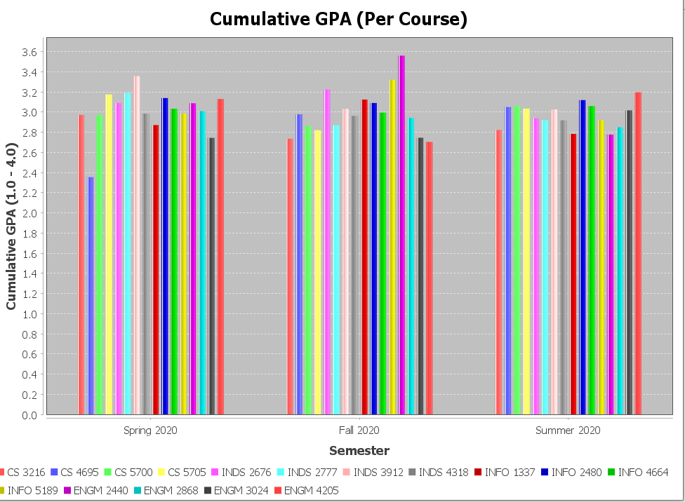
The experiment

Slide 12
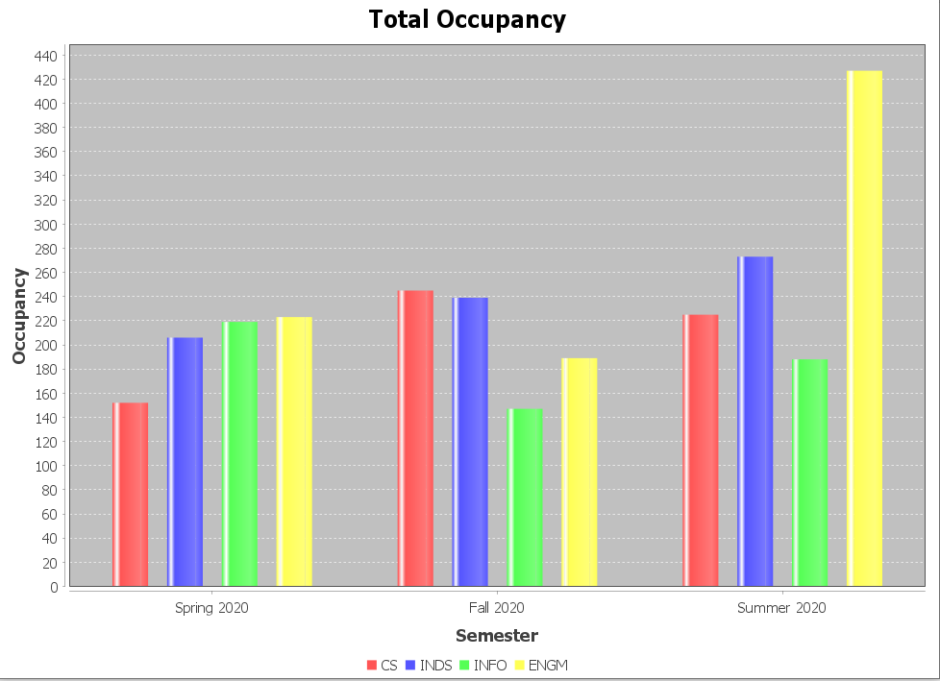

Slide 13
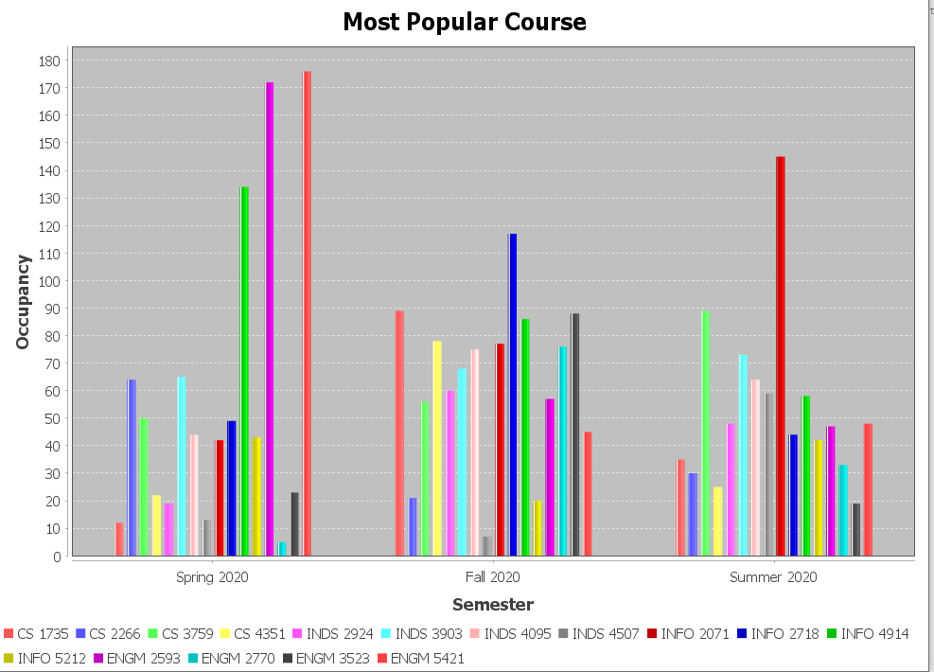

Slide 14
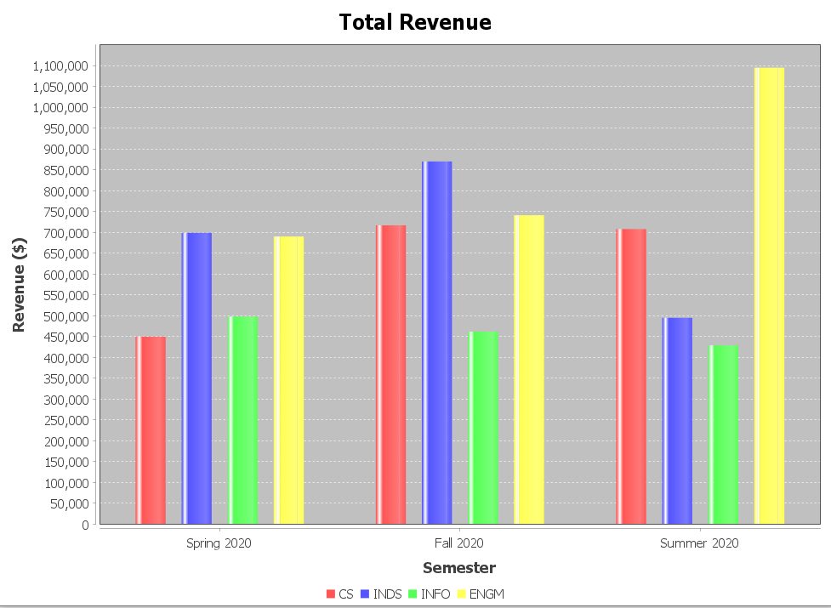

Slide 15
Conclusion
With the help of given dashboards, we can rank the following for the 3 semesters in the year 2020
Highest cumulative GPA for each course offered amongst all the departments
Total number of seats occupied by every department
Most popular course by the department
Total revenue generated by each department

Slide 16
Solution for K-12 educational System

Slide 17
The Feedback forms can also be used in K-to-12 education system where students from higher classes can give feedback about their instructors so that instructors get to know the changes, they are supposed to make in their teaching methods
The same way K-to-12 education system can get information from their alumni students whether the university they have landed for their bachelors was because of the certifications they did other than school studies or just the school syllabus helped them to reach there.
At the end of the educational year in K-to-12 educational system students will be rating the courses they were taught an according the ratings the teachers can make changes in their curriculum for the upcoming batches.

Slide 18
Implementation to k-to-12 educational systems
These same feedback forms can be implemented in K-to-12 education system where after the courses are ranked ,the one ranked in the lasts can be worked up by the schools for better output of the courses.
In K-to-12 education system the salary can be replaced by the type of university a student is admitted to in their bachelors. So, when a student sets the range of the university like ambitious or approachable or guaranteed, our implementation will provide him with the name of students in those universities and certifications they gained.
Same implementation can be followed for K-to-12 education system where students are ranked according to their percentage and if a good number of students does not come in the range of good percentage ,through this instructors can analyze and work upon their teaching methods.

Slide 19
Thank You

